Slide 1

Academic Literacy
Week 5 Thursday Preparation
Arguing from sources
Notes:
Academic writers argue about how to interpret theories and concepts, how to conduct research and how to solve problems. They present arguments in order to move the discussion forward – to add something new to the discussion. They never simply repeat the arguments of other writers. In this session you will see how to argue from sources, bringing in your own academic voice to redefine, analyze, critically compare and evaluate.

Slide 2

Aims
Notes:
At university knowledge is advanced by considering temporary and conditional viewpoints. Knowledge is said to be contingent, based on the best evidence currently available but this could change as more research data are gathered. Academic researchers develop criteria for evaluating knowledge claims in published research. They take a stance in relation to these claims and defend it with evidence from their own research. These arguments are most often found in literature reviews and discussion sections of research articles. In this session you will work with an assignment task that requires argument so that you can develop a framework for activating writer’s voice. You will see how to use sources to move an argument on.

Slide 3
Link to Academic Literacy exam
At the end of your PSE Online programme, you will have an Academic Literacy exam.
You will be guided to read two texts so that you can take notes to answer an essay question.
The essay question will take the form
‘To what extent…?’
The learning outcomes this week will help you to achieve good marks in this exam.
Notes:
At the end of your PSE Online programme, you will have an Academic Literacy exam.
You will be guided to read two texts so that you can take notes to answer an essay question.
The essay question will take the form ‘To what extent…?’
The learning outcomes this week will help you to achieve good marks in this exam.

Slide 4

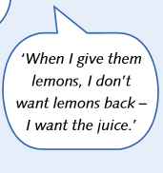
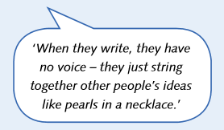


In these metaphors
what do the lemons represent?
what does the juice represent?
What do the pearls represent?
Notes:
Turn to page 196 of your coursebook and review your discussion from Tuesday on the meaning of these metaphors. How is stringing together pearls on a necklace the same as using academic sources without a voice? How is getting lemons and giving back lemons the same as using academic sources descriptively but not persuasively.

Slide 5
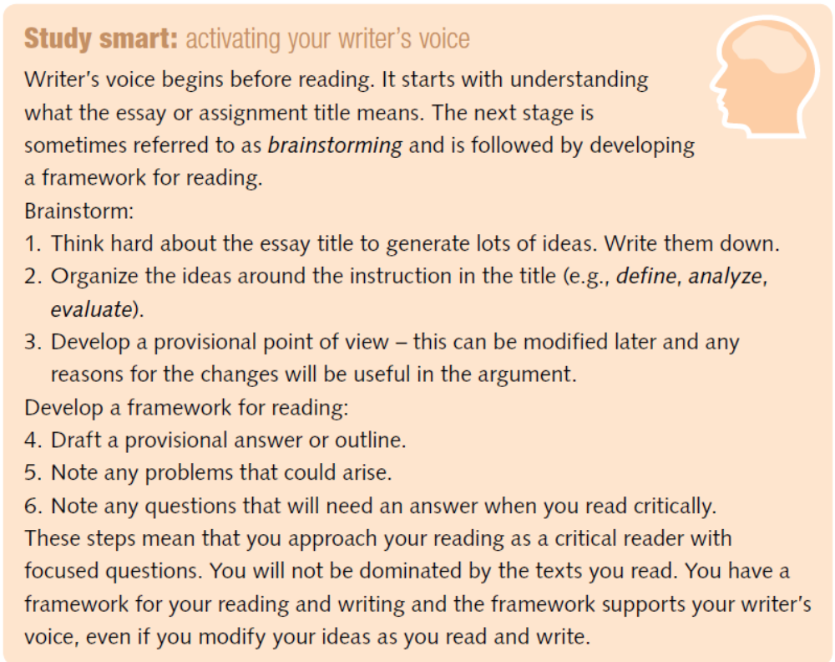
Activating writer’s voice
Turn to p 208 to read the Study Smart
Do you think brainstorming & developing a reading framework happen at the same time or sequentially?
Notes:
In order to activate your writer’s voice, you need to be in control of your sources. This means you have to understand an assignment question and develop your own provisional point of view. This may change later as you read. Brainstorming and reading are part of an iterative process, i.e. both happen together and complement each other. Your aim is to develop focused critical questions to guide reading, through the selection and critical evaluation of sources.

Slide 6
Planning an assignment with writer’s voice
Mauricio is a PhD student in the School of Health.
He supervises a tutorial group of undergraduate students.
The group has been set an assignment question:
    Critically evaluate definitions of health as a concept for health professionals (400 – 500 words)
The assignment is quite short and Mauricio has provided a reading list.
Take only 1 minute to look quickly at the reading list on page 210 to decide why these sources were chosen.
Notes:
Mauricio is a PhD student in the School of Health.
He supervises a tutorial group of undergraduate students.
The group has been set an assignment question:
Critically evaluate definitions of health as a concept for health professionals (400 – 500 words)
The assignment is quite short and Mauricio has provided a reading list.
Take only 1 minute to look quickly at the reading list on page 210 to decide why these sources were chosen.

Slide 7
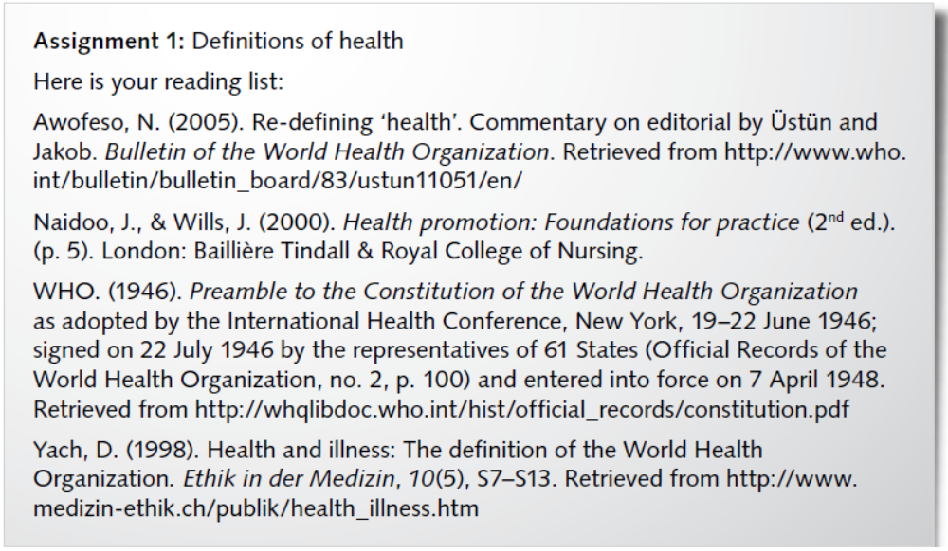
Surveying sources
Why were these sources chosen for essay question:
    Critically evaluate definitions of health as a concept for health professionals
Notes:
Why were these sources chosen for the essay question? Take only 1 minute to read through this reading list quickly to highlight key words in the titles of these sources which relate to the essay question: Critically evaluate definitions of health as a concept for health professionals

Slide 8
Surveying sources
Notes:
The oldest source dates from 1946, the WHO definition of health. That might form the starting point for a critical evaluation. More recent sources such as Awofeso and Yach refer to the WHO definition, re-defining or contrasting with illness. Naidoo and Wills refer to practice. Students have to critically evaluate definitions of health for practice, i.e. for health professionals in their daily working lives.

Slide 9
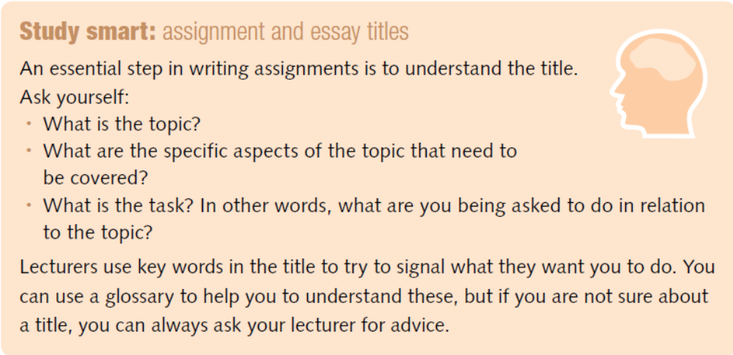
Understanding the assignment title
Read the Study Smart on page 208. Use the steps to understand the essay question:
    Critically evaluate definitions of health as a concept for health professionals
Notes:
Read the Study Smart on page 208. Use the steps to understand the essay question:
Critically evaluate definitions of health as a concept for health professionals
What is the topic? What aspects of the topic need to be covered? What instruction word tells you the task? What does the task ask you to do in relation to the topic? Is there a perspective, in other words a particular viewpoint to be taken into consideration?

Slide 10
Understanding the assignment - answers
What is the topic? Health
What aspects of the topic need to be covered? Definitions of health
What instruction word tells you the task?
Critically evaluate
What does the task ask you to do in relation to the topic? Assess whether definitions of health are useful.
Is there a perspective, in other words a particular viewpoint to be taken into consideration?
For health professionals, i.e. for practice.
Notes:
The topic is Health
The aspect to be covered is Definitions of health
The instruction word that tells you the task is Critically evaluate
In relation to the topic, the task asks you to Assess whether definitions of health are useful.
There is a perspective - a particular viewpoint to be taken into consideration.
The definition should be useful for health professionals, i.e. for practice.

Slide 11
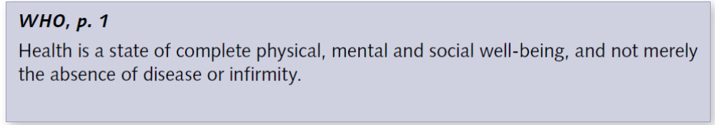
Brainstorming a concept
Look at the WHO definition in relation to the essay question
  Critically evaluate definitions of health as a concept for health professionals.
Is this state of health achievable?
Is it useful for health professionals such as nurses, doctors or care workers?
Notes:
In order to critically evaluate definitions of health, it could be useful to start with an early definition, that is the World Health Organisation definition of 1946. We can ask some critical questions about this definition.
In your view, is this state of health achievable?
Is it useful for health professionals such as nurses, doctors or care workers?

Slide 12
Brainstorming what you know
Why is this concept important?
Think about the health service in your country
Can you think of situations when a definition of health would be necessary?
Could someone with a physical disability or a mental health problem ever be defined as healthy?
Notes:
Why is this concept important?
Think about your own experience of the health service in your country
Can you think of situations when a definition of health would be necessary?
Could someone with a physical disability or a mental health problem ever be defined as healthy?

Slide 13
Surveying the sources
Look at the extracts from the sources by Awofeso (2005), Naidoo & Wills (2000) and Yach (1998) on p 211.
Which one largely describes definitions of health?
Which two adopt a critical perspective on the WHO definition? These are likely to be the most useful.
Write some focused questions to guide critical reading.
Make notes on the points from these sources that answer your critical reading questions.
NOTE: this is the type of task you will be asked to do in the Academic Literacy exam.
Notes:
Look at the extracts from the sources by Awofeso (2005), Naidoo & Wills (2000) and Yach (1998) on p 211.
Which one largely describes definitions of health?
Which two adopt a critical perspective on the WHO definition? These are likely to be the most useful.
Write some focused questions to guide critical reading.
Make notes on the points from these sources that answer your critical reading questions.
NOTE: this is the type of task you will be asked to do in the Academic Literacy exam.

Slide 14
Selecting ideas from the sources
Which points from these sources would you include in an answer to the essay title.
Draft an outline plan to answer this essay question.
  How would you introduce the topic?
  What structure would be most persuasive?
Map ideas from your notes onto your outline plan
NOTE: this is the type of task you will be asked to do in the Academic Literacy exam.
Notes:
Which points from these sources would you include in an answer to the essay title.
Draft an outline plan to answer this essay question.
How would you introduce the topic?
What structure would be most persuasive?
Map ideas from your notes onto your outline plan
NOTE: this is the type of task you will be asked to do in the Academic Literacy exam.

Slide 15
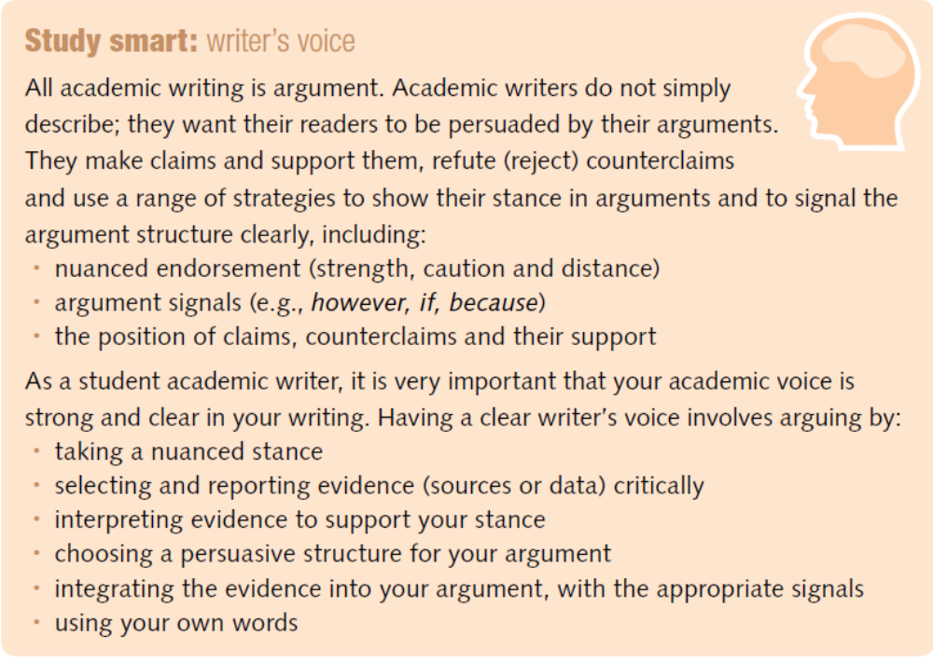
Review your understanding of writer’s voice
Read the Study smart on p 197
Notes:
Mauricio told the students in his tutor group that he wanted to hear their own voices in their essays. His advice was
Take a nuanced stance
Select and critically report evidence from the sources
Interpret this evidence to support your stance
Choose a persuasive structure for your argument
Integrate the evidence into your argument, with the appropriate argument signals and use your own words – your voice – rather than copying exactly from the sources.

Slide 16
Evaluating student writing – a case study
Turn to p 212 of the coursebook to answer Task 4
Read the two student answers on pages 212 and 213.
4.1 Which student has answered the question effectively by moving the discussion forward beyond the sources?
4.1 Which students displays very little writer’s voice?
4.2 Look at the two introductions. Which student addresses the essay question more effectively?
4.2 How do the students show they are moving (or not moving) the discussion forward.
4.3 Justify your answers in 4.1 & 4.2 with Mauricio’s criteria
Notes:
Turn to p 212 of the coursebook to answer Task 4
Read the two student answers on pages 212 and 213.
4.1 Which student has answered the question effectively by moving the discussion forward beyond the sources?
4.1 Which students displays very little writer’s voice?
4.2 Look at the two introductions. Which student addresses the essay question more effectively?
4.2 How do the students show they are moving (or not moving) the discussion forward.
4.3 Justify your answers in 4.1 & 4.2 with Mauricio’s criteria

Slide 17
Evaluating student writing – a case study
4.1 Which student takes the lemons (the sources) and extracts the juice? Which student creates a string of pearls?
4.2 Compare the thesis statements, In this essay, I will…
Which student moves the argument forward with a purpose for the definition which opens out the scope?
Which student presents a conclusion that closes off the scope of the essay?
Notes:
4.1 Which student takes the lemons (the sources) and extracts the juice? Which student creates a string of pearls?
4.2 Compare the thesis statements, In this essay, I will…
Which student moves the argument forward with a purpose for the definition which opens out the scope?
Which student presents a conclusion that closes off the scope of the essay?

Slide 18
Evaluating student writing – a case study
4.3 a Which student takes a nuanced stance and defends it and which student takes a stance and repeats it?
4.3 b Which student has a framework that relates to the assignment (evaluates) and which student traces development from the source ideas?
4.3 c Which student interprets ideas from sources, e.g. what they imply, and includes her own background knowledge?
4.3 d & e Which student inserts her own examples and her own conclusions?
4.3 Which student does not focus on the essay title?
Notes:
4.3 a Which student takes a nuanced stance and defends it and which student takes a stance and repeats it?
4.3 b Which student has a framework that relates to the assignment (evaluates) and which student traces development from the source ideas?
4.3 c Which student interprets ideas from sources, e.g. what they imply, and includes her own background knowledge?
4.3 d & e Which student inserts her own examples and her own conclusions?
4.3 Which student does not focus on the essay title?

Slide 19
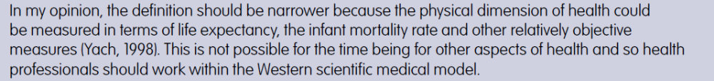
How close to plagiarism is student B’s text?
Compare the extracts from Awofeso (2005) & Yach (1998) with Student B’s conclusion below.
How close does student B come to plagiarism?
What should she have done to avoid this?

Slide 20
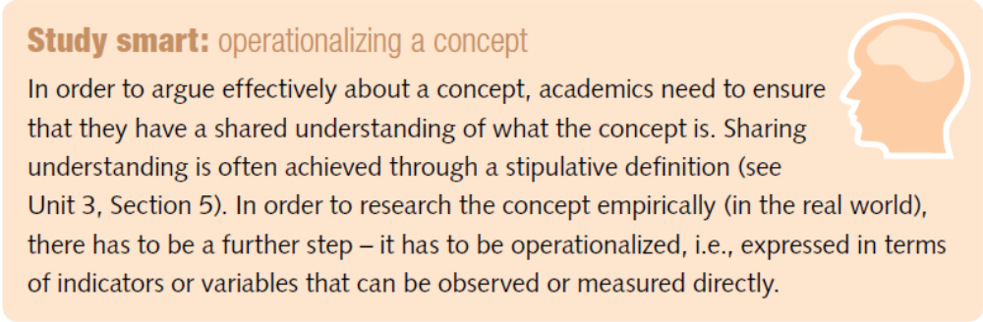
Operationalizing a concept
In her final paragraph, Student A says ‘…any definition of health has to be translated into variables that can be measured’. This process is known as operationalization.
Task 5: In the final paragraphs of the students’ texts, find two ways to operationalize the concept of health. Suggest others.
Notes:
In her final paragraph, Student A says ‘…any definition of health has to be translated into variables that can be measured’. This process is known as operationalization.
Task 5 in the final paragraphs of the students’ texts, find two ways to operationalize the concept of health. Suggest others.

Slide 21
Operationalizing a concept
In week 3, you were introduced to the concept of student engagement. This definition is from Bryson & Hand (2007).
  Student engagement is understood as the interaction a student has with their learning environment & the […] degree of involvement on the part of students, teachers & institutions which can support or hinder their learning.
The concept was operationalized as ‘observable behaviour showing interaction with the learning environment, the objects of learning and teacher/peers’.
Observable behaviour was analysed into a framework of specific components as on the next slide.
Notes:
In week 3, you were introduced to the concept of student engagement. This definition is from Bryson & Hand (2007).
Student engagement is understood as the interaction a student has with their learning environment & the […] degree of involvement on the part of students, teachers & institutions which can support or hinder their learning.
The concept was operationalized as ‘observable behaviour showing interaction with the learning environment, the objects of learning and teacher/peers’.
Observable behaviour was analysed into a framework of specific components as on the next slide.

Slide 22
Framework for engagement
Component of concept | Observable behaviour – we can see this in a classroom
Being active as instructed by teacher | Asking questions
 | Working with other students
Mental activities | memorizing
 | analysing
Interaction as chosen by student | Interacting with lecturers
 | Interacting with other students
Student identity | Views on the purpose of education
 | Active member of wider society beyond university
 | Independent and autonomous, self-sufficient
Notes:
The general components of the concept of engagement shown on the left have been translated into behaviour that can be observed or measured.
In your Collaborate sessions, your teacher is giving you a mark out of five for your contribution. She or he observes you and gives credit for the highlighted components: asking questions, working in breakout groups with other students; showing that you have worked independently to prepare for each Collaborate session. We could collect this data and compare it to your final results in coursework and exams to assess the extent to which engagement with learning online correlated with good marks in your assessments.

Slide 23
Operationalizing your concept
Think about the concept you have chosen to explore in your annotated bibliography.
Can you suggest some components that form part of the overall concept?
Can you specify a measurement or some observable behaviour that would enable you to operationalize the concept for research purposes, i.e. so that you could gather data?
Check in the methodology sections of the articles you have chosen to include in your bibliography.
How have the researchers operationalized the concept?
Notes:
Think about the concept you have chosen to explore in your annotated bibliography.
Can you suggest some components that form part of the overall concept?
Can you specify a measurement or some observable behaviour that would enable you to operationalize the concept for research purposes, i.e. so that you could gather data?
Check in the methodology sections of the articles you have chosen to include in your bibliography.
How have the researchers operationalized the concept?

Slide 24
Investigating key language for reporting
In Unit 2, Section 4 pp 41 – 49, you looked at how published academic writers report ideas from sources using a confident writer’s voice:
  writers link claims into a logical research narrative
  the sources support this story; they don’t control it
  writers choose to give more space to ideas from sources that support their own viewpoint
  writers choose reporting verbs and adjectives to show their stance in relation to the sources.
Look at Student A’s text and find examples of her voice.
Notes:
In Unit 2, Section 4 pp 41 – 49, you looked at how published academic writers report ideas from sources using a confident writer’s voice:
writers link claims into a logical research narrative
the sources support this story; they don’t control it
writers choose to give more space to ideas from sources that support their own viewpoint
writers choose reporting verbs and adjectives to show their stance in relation to the sources.
Look at Student A’s text and find examples of her voice.

Slide 25
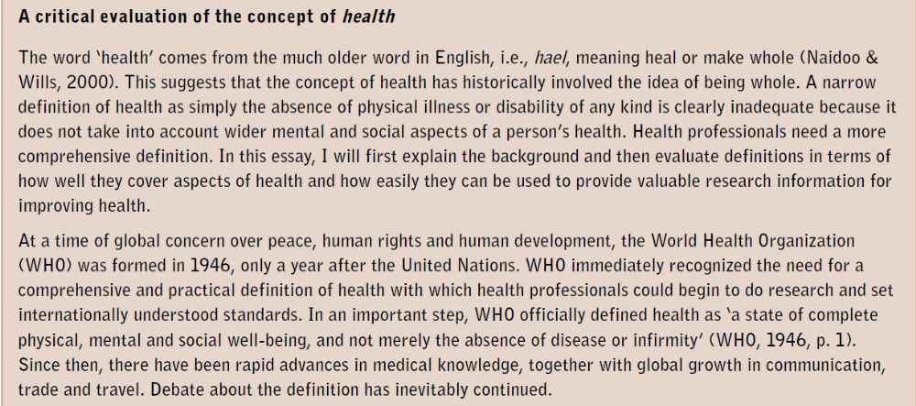
Examples of writer’s voice
Examples of persuasive language & reporting verbs

Slide 26
Preparing for Collaborate
In your Collaborate session your teacher will assign you to a group to compare:
  the questions you wrote to guide critical reading
  the notes you made from the sources
  the outline plan you made to answer the question
    Critically evaluate definitions of health as a concept for health professionals
You will then compare your plan with the effective student answer to assess similarities & differences.

Slide 27
Follow up activities
Review your annotated bibliography introduction. Have you used a confident writer’s voice:
  developing a logical argument for your purpose
  using sources to support this story not control it
  giving space to ideas relevant to your purpose
  choosing reporting verbs and adjectives to show your stance in relation to the sources.

Slide 28

Any questions?

